Slide 1
RAN outlook – Rel16 and beyond
RWS-180020
3GPP Workshop on IMT2020 submission
24-25 October, 2018
Bruxelles, Belgium
Balazs Bertenyi (Chairman of 3GPP RAN)

Slide 2

Outline
5G vision driving the evolutionary path
5G evolution: Expansion and Efficiency

Slide 3
5G vision - for real
Perfect storm of multiple technology breakthroughs:
Low latency radio with fully flexible network
Artificial Intelligence and Automation
Device revolution for AR/VR
Vertical industries going cellular

Slide 4
Timeline
2017
2018
2019
2020
Q4
Q1
Q2
Q3
Q4
Q1
Q2
Q3
Q4
Q1
Rel-15 NSA (option-3)
freeze
Rel-15 NSA (option-3)
ASN.1
Rel-15
freeze (incl 5G SA)
Rel-15
ASN.1 (incl 5G SA)
Rel-15 late drop freeze
Rel-15 late drop ASN.1
Rel-16 Study phase
Rel-16 Study and Normative phase
Rel-16
freeze
Rel-16
ASN.1

Slide 5
Release 16 – 5G Expansion
2018 Q3
2018 Q4
2019 Q1
2019 Q2
2019 Q3
2019 Q4
5G Vehicle to X (V2X)
5G Industrial IoT
5G Expansion
5G URLLC enhancements
5G for Unlicensed spectrum operation
5G for Satellite
5G above 52.6GHz

Slide 6
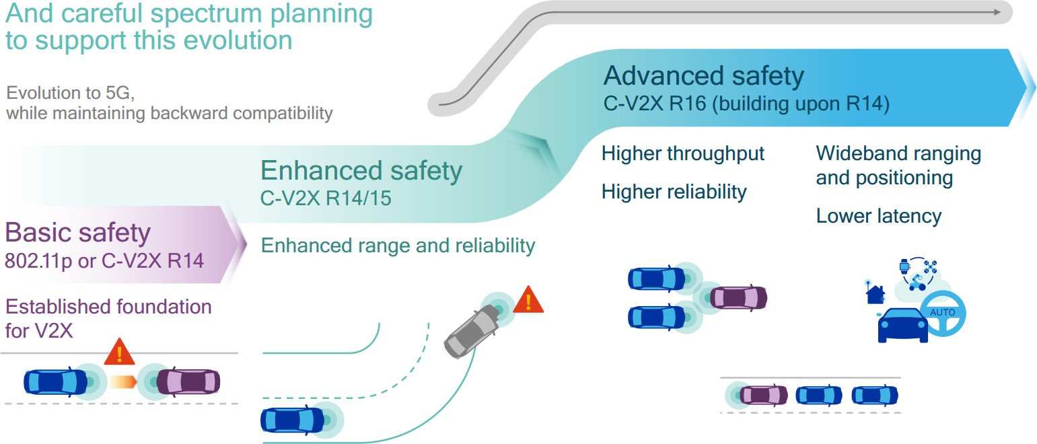

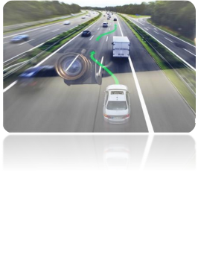


V2X evolution towards 5G
Vehicle Platooning
Cooperative Manoeuver,
Sensor sharing
Basic Safety services
incl. warnings and signal
phase information
Remote Driving
Advanced Driving

Slide 7

Industrial IoT and URLLC
Focus on both commercial and industry use
  AR/VR, Factory automation, Transport Industry (incl Automotive), Electrical Power Distribution
Establishing Rel15 baseline performance
Time Sensitive Networking (TSN)
  Accurate reference timing, wireless Ethernet, etc…
Reliability and latency enhancements: L1/L2/L3 concepts
Intra-UE prioritization and multiplexing

Slide 8
5G NR in unlicensed bands
3GPP work on unlicensed operation will be focused on NR
  No new functions on LTE-LAA
NR-U specifications kept separate, not part of the ITU submission
Focus is on bands below 7GHz
Addresses both LAA and Standalone operation
Co-existence with LTE-LAA and other incumbent technologies

Slide 9
Release 16 – 5G Efficiency
2018 Q3
2018 Q4
2019 Q1
2019 Q2
2019 Q3
2019 Q4
Interference Mitigation
5G SON & Big Data
5G MIMO enhancements
5G Efficiency
5G Location and positioning enhancements
5G Power Consumption improvements
Dual Connectivity enhancements
Device capabilities exchange
Mobility enhancements
Non-orthogonal Multiple Access (NOMA)

Slide 10
Positioning in 5G
Going beyond basic regulatory requirements (E911)
Start with identifying accuracy, latency, capacity and coverage requirements
Both commercial and regulatory scenarios
Both indoor and outdoor
Both low (FR1) and high (FR2) frequency bands

Slide 11
Balance
5G Expansion
5G Efficiency

Slide 12
5G vision – where are we?
Perfect storm of multiple technology breakthroughs:
Low latency radio with fully flexible network
Artificial Intelligence and Automation
Device revolution for AR/VR
Vertical industries going cellular

Slide 13

Thank you!
Balazs Bertenyi
Chairman of 3GPP RAN
balazs.bertenyi@nokia.com
+36 20 9849152

